Slide 1

Development of an automatic spelling correction tool for analyzing clinical text in Russian
Student: Dmitry Pogrebnoy, J41332c
Supervisor: Sergey Kovalchuk, PhD

Slide 2
Electronic medical records
In healthcare, there are various predictive and decision-making models based on information from patients' medical records
The quality of such models strongly depend on the quality of the source texts
Electronic patient data is usually presented in plain text and contains a lot of spelling errors
Spelling errors in the source texts greatly reduce the quality of the final models and therefore require correction
2/10

Slide 3

Goal and tasks
Goal: Design a method and implement an automatic spelling correction tool for analyzing clinical texts in Russian.
Tasks for second semester:
Design the spelling correction process
Design the architecture of a new spellchecker tool
Implement prototype of new tool
Conduct testing of the developed tool
3/10

Slide 4
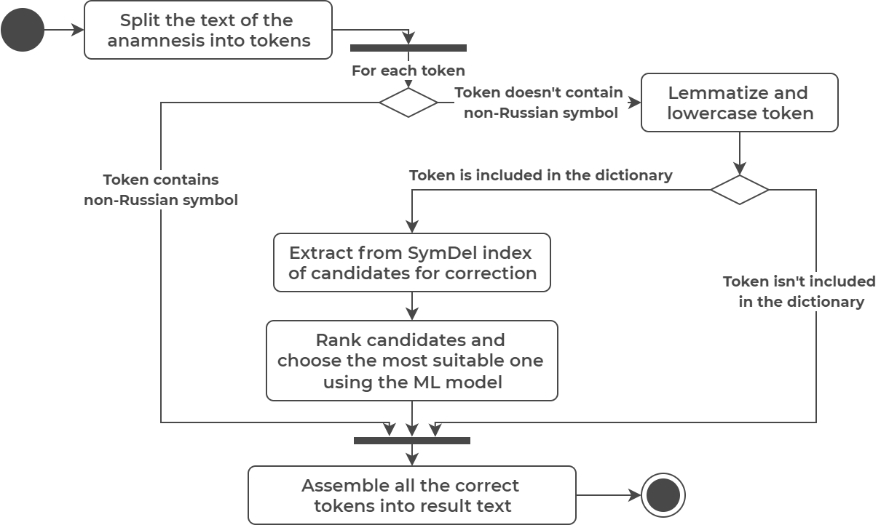
Spelling correction process
4/10

Slide 5
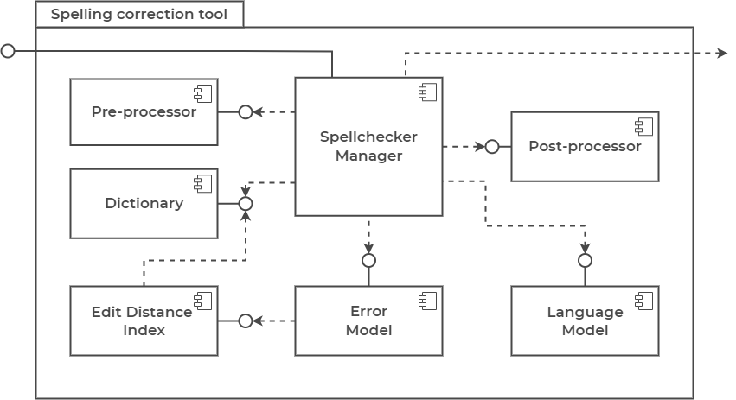
Tool architecture
5/10

Slide 6
Single word test
Tool | Error precision | Lexical precision | Overall precision | Average words per second
Aspell-python | 0.65 | 0.775 | 0.7125 | 353
PyHunspell | 0.59 | 0.49 | 0.54 | 11.5
PyEnchant | 0.6 | 0.455 | 0.5275 | 26.4
LanguageTool-python | 0.64 | 0.845 | 0.7425 | 19.1
PySpellChecker | 0.335 | 0.765 | 0.55 | 4.3
SymspellPy | 0.42 | 0.78 | 0.6 | 15892.1
Jumspell | 0.395 | 0.925 | 0.66 | 2043.2
New tool (CPU) | 0.45 | 0.95 | 0.7 | 8.4
New tool (GPU) | 0.45 | 0.95 | 0.7 | 12.5
6/10

Slide 7
Context word test
Context test contains 60 samples
Test sample – 10 words, one of which has a spelling error
Metric | CPU mode | GPU mode
Error precision | 0.7 | 0.7
Lexical precision | 0.98 | 0.98
Overall precision | 0.84 | 0.84
Average words per second | 51.5 | 100
7/10

Slide 8
Conclusion
The new spelling correction process is designed
The architecture of the new spellchecker tool is designed
The prototype of the spell checker tool is implemented
Testing of the developed tool is conducted
The project was presented at the XI Congress of Young Scientists
8/10

Slide 9
Further plans
Improve and optimize the spelling correction process
Try to fine-tune other language models based on BERT
Conduct more wide-ranging testing and approbation
Measure the effect of the developed tool on medical models
9/10

Slide 10

Thank you for your attention!
www.ifmo.ru

Slide 11
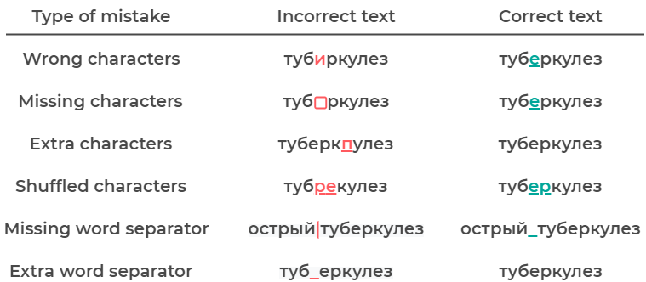
Spelling errors in question
11/10

Slide 12
Single word test internals
Error precision - the ratio of the number of correctly corrected words to the total number of incorrect words
200 medical words with spelling errors were taken to compute error precision
Lexical precision - the ratio of the number of unchanged modified words to the total number of correct words
200 correct medical words were taken to compute lexical precision
The performance test was done on a laptop on Ubuntu 20.04 with 16 GB RAM and Intel Core i7-9750H CPU @ 2.60GHz * 12
12/10

